Slide 1
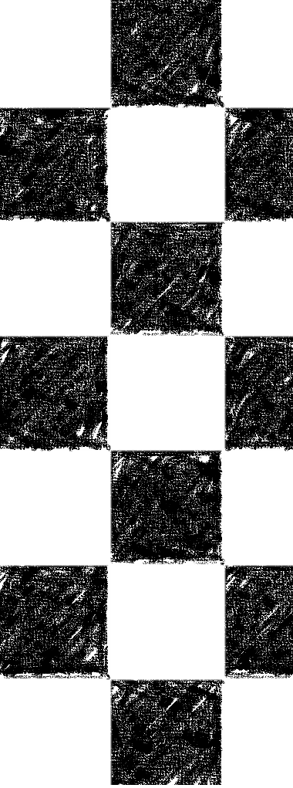

Automatic camera calibration using video sequence
Final Project for 02504 Computer Vision
Magnus Eilersen Ioannis Koutsoukidis

Slide 2
Project proposal
Development of automatic camera calibration system
Video of chessboard pattern shown on a screen
Two main advantages over the conventional Zhang method:
Wider point distribution of points
Automatic process with no manual movement required
Further steps
Evaluate results of the automatic calibration
Compare with results taken from conventional calibration using manual image acquisition

Slide 3
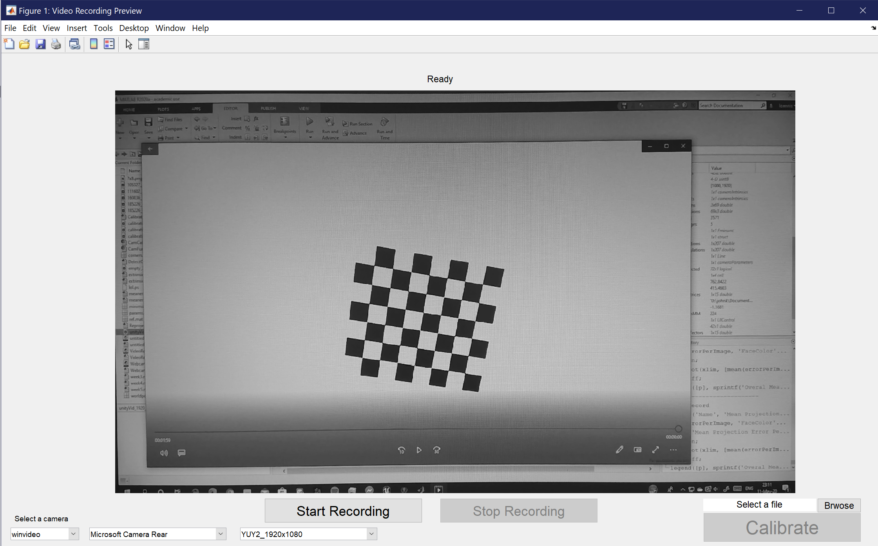
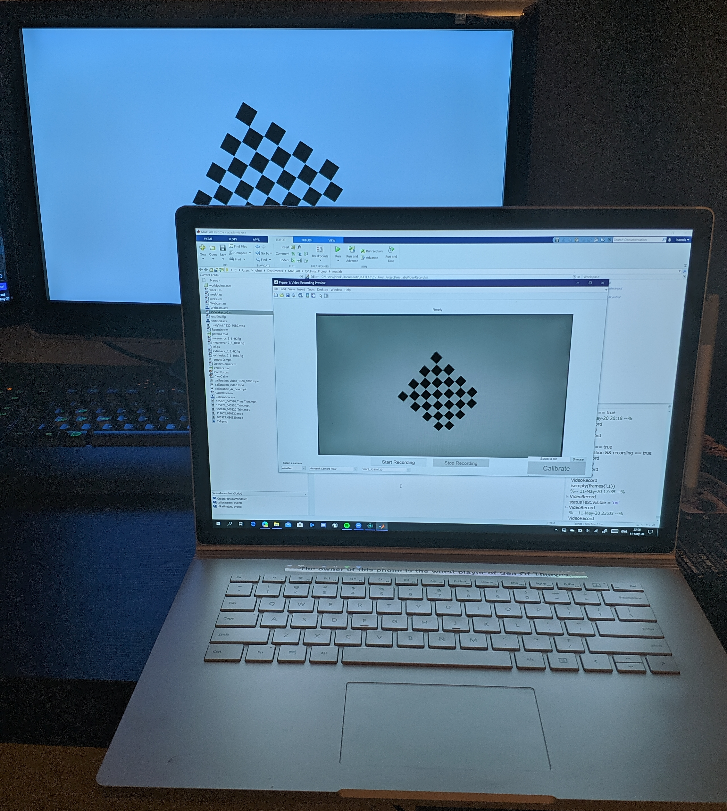
The setup
Record a sequence
Perform calibration
Calibrate using an earlier recorded video
Notes:
Process:
1 – Set the camera in front of the screen
2 – Adjust the position so that the camera can record the whole screen, and that the screen covers the entire camera view
3 – Record video of the screen
4 – Sample the video and get some pictures from it
5 – Detect the chessboard and the corners on each of the sampled pictures
6 – Estimate the camera parameters
7 – Further refine the parameters by nonlinear optimization

Slide 4
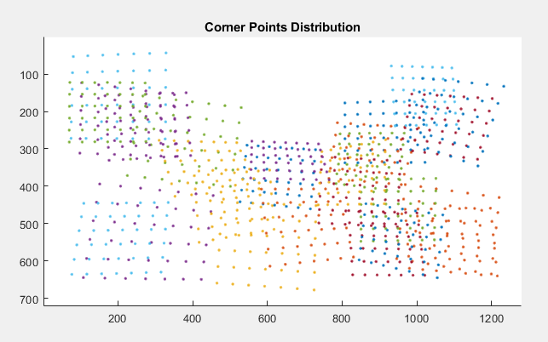
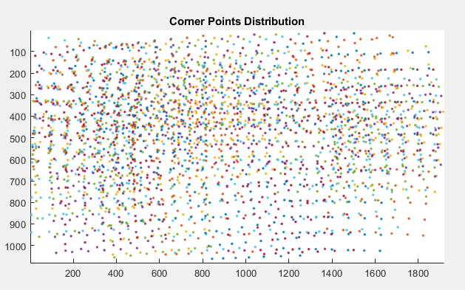
POINTS DISTRIBUTION
CONVENTIONAL METHOD
VIDEO METHOD
Video method points are distributed better across the entire camera view
Video allows for more variation
Notes:
Manual calibration requires a person to hold a chessboard pattern on a flat surface, and move the surface while taking pictures, trying to get as many different angles as possible. This is a laborious process that takes time, and the captured images don’t include a broad point distribution.
Using the video we can get many more images with no human effort required, which results in more angles and more points, especially near the edges of the screen.
This higher density and variation of points will help improve the result of the calibration algorithm

Slide 5

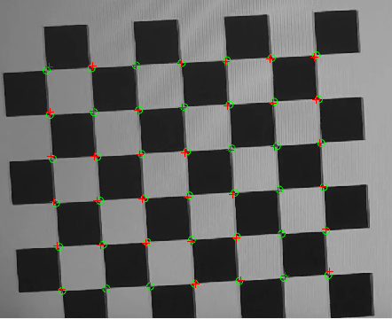


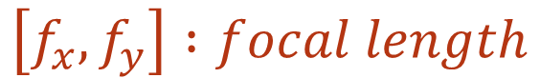

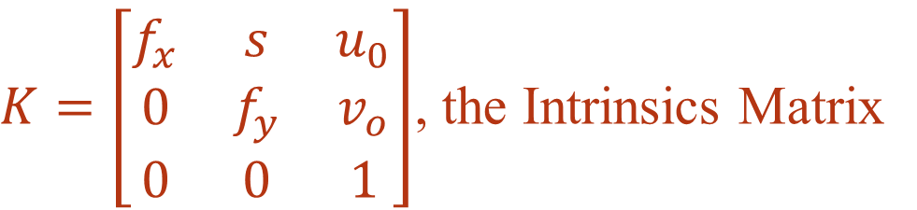


Reprojection error
Using Zhang’s calibration method we get the camera Intrinsics:
$K=\left[\begin{matrix}f_{x} & s & u_{0} \\ 0 & f_{y} & v_{o} \\ 0 & 0 & 1\end{matrix}\right]$, the Intrinsics Matrix
$$\left[f_{x},f_{y}\right] :focal length$$
$$\left[u_{0},v_{0}\right] :principal point$$
$$s :Skewness$$
$And d=[k_{1, }k_{2}, …]$, the distortion coefficients
And Extrinsics, per image
Reprojecting a chessboard pattern using the estimated parameters is not fully accurate as the parameters are derived based on algebraic error
$$R :Rotation Matrix$$
$$t :Translation Vector$$
Notes:
Using Zhang’s calibration algorithm, we can estimate the camera parameters, namely the intrinsic matrix K, which includes the focal length, the principal point coordinates and the skewness of the lens, the distortion coefficients, as well as the extrinsic parameters R, the rotation Matrix and t, the translation vector for each image.
Having these estimates allows us to reproject an identical chessboard pattern on the image plane, in an attempt to generate an image similar to the original.
The parameters, however, are estimated, and thus the reprojected image differs from the original. The distance between the reprojected points and the points found in the original image is the reprojection error.

Slide 6
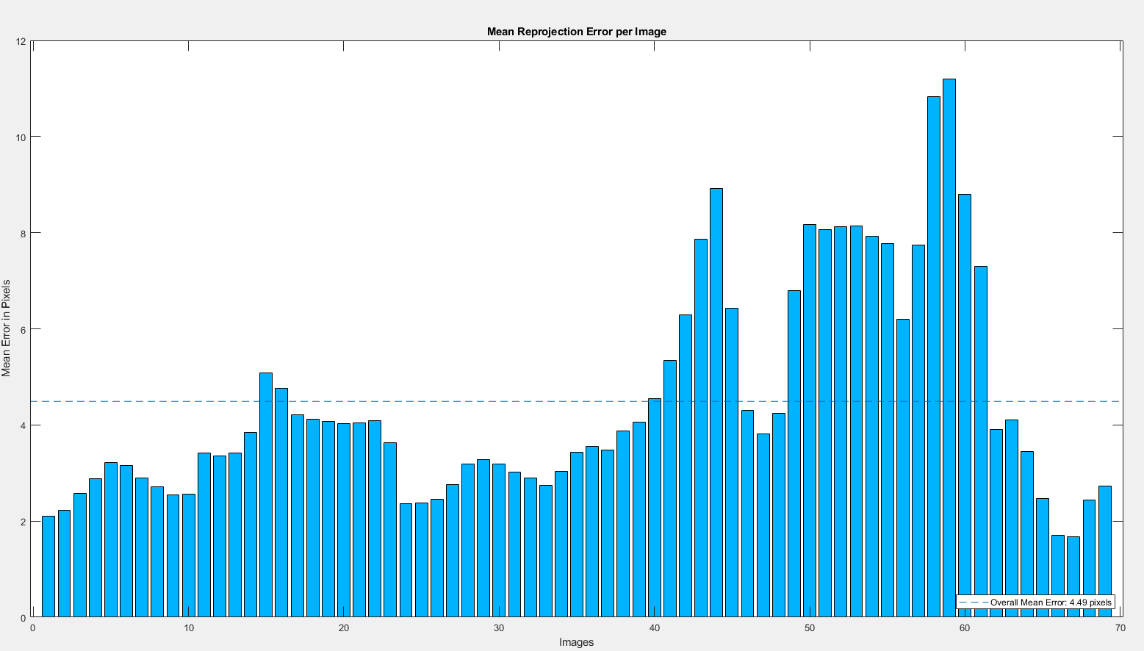
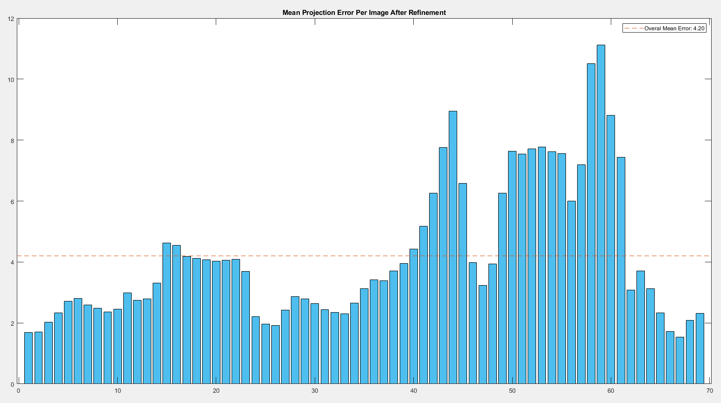
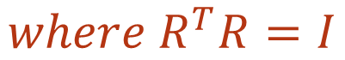
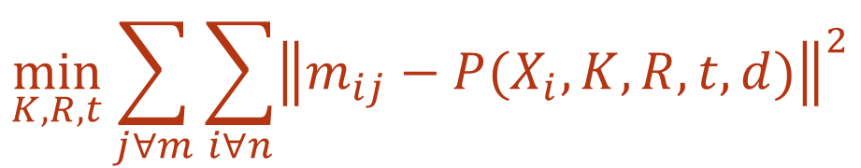
NONlinear parameter refinement
BEFORE REFINEMENT
AFTER REFINEMENT
Mean: 4.49
Mean: 4.20
The parameters we get from the camera calibration using Zhang’s algorithm can be further refined by running a nonlinear optimization by minimizing the total error among all images
$$\min_{K,R,t}{\sum_{j∀m}{\sum_{i∀n}{{\left\|m_{ij}−P(X_{i},K,R,t,d)\right\|}^{2}}}}$$
$$where R^{T}R=I$$
Notes:
The above figures are the result of the optimization when run on a video recorded using an early version of the pattern.
The goal is to minimize the total error sum of all the images in the sample, which can be achieved by trying different values for all the camera parameters, and getting the best result.
This is a lengthy process, and returns the best values found for both the Intrinsics as well as new rotations matrices and translation vectors for each image.

Slide 7
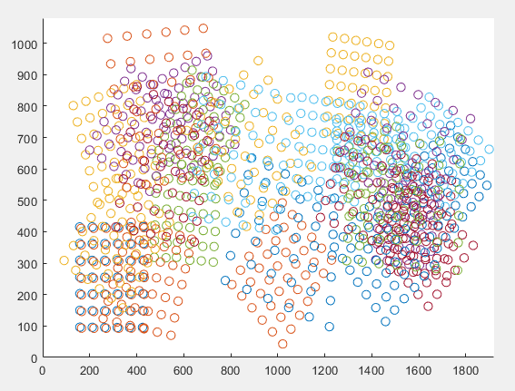
Results
 | Manual Calibration | Video Calibration
Before nonlinear refinement | 0.82 | 0.37
After nonlinear refinement | 0.76 | 0.35
The results of the automatic process are significantly better than those of the manual process (more than half the mean error for this particular test)
The nonlinear refinement improved the results, but the improvement was more apparent in the manual calibration, as the error values that we got from the automatic calibration were very low already
Point Distribution for the manual calibration
Notes:
The results we got from the system were generally very positive, and consistently better than our manual test trials.
When applying nonlinear refinement the errors were reduced slightly, but this reduction was more noticeable in the manual test images, as there was a lot more room for improvement there, compared to the images from the automatic test, for which the error was already very low after the initial linear estimation of the parameters.

Slide 8
Conclusion
For this project we examined an automatic camera calibration system, using a video showing a chessboard pattern on a screen as the source for images
The system we worked on reduces user action required to calibrate a camera
It is a robust approach, producing results comparable or even better than those produced by the conventional manual approach
The system further refines the estimated parameters using nonlinear optimization of the variables
Notes:
To summarize, Maguns and I worked on developing a system that can calibrate a single camera using a video of a chessboard pattern shown on another monitor, which is in turn recorded by the camera we want to calibrate.
The process of the calibration aims to reduce the user action required, which can be tedious and prone to human error, and also allows us to include a bigger variety of images used for the calibration.
The initial results of the system were positive, showing comparable outcome to the conventional manual method, and even smaller errors in most of our tests.
Finally, the estimated parameters are further refined using nonlinear optimization, to achieve even better results, and a better calibration model.

